Slide 1
Chapter 8
Benefit-Cost Analysis: Cost

Slide 2
Learning Objectives
Explain how the concept of opportunity cost can apply to environmental regulations.
Define the with - without principle and how it applies to benefit-analysis.
Distinguish between the private and social costs of a project and provide an example.
Explain how to measure the social costs of a regulation when industry output adjusts.
Define what is meant by the incidence of a policy and provide an illustration graphically of how the share paid by consumers versus producers is determined.

Slide 3
What are Opportunity Costs?
In Economics the most fundamental concept of costs is opportunity costs.
The opportunity cost of using resources in a certain way is the highest-valued alternative use to which those resources could have otherwise been directed.

Slide 4
What are Opportunity Costs?
Costs are generated by all types of
firms,
industries,
agencies and
groups.
Each group generally focuses on those costs that directly affect that group. (Example: a bicycle path)
The concept of social opportunity costs covers all costs that affect any member or group in society.

Slide 5
Opportunity Costs and Environmental Regulation
Environmental programs often have social costs associated with them (if we consider the fact that most of our specific emissions-reduction programs are media-based; that is, they are aimed at reducing emissions into one particular environmental medium like air or water. So when emissions into one medium are reduced, they may increase into another)
For example scrubbing SO2 out of power plant emissions creates cleaner air, but leaves a concentrated sludge that must be disposed. This cost of disposal must be factored into the cost of producing clean air.
Unintended consequences (e.g., midnight dumping)

Slide 6
What is it about?
During the 1970s, the federal government introduced a two-price system for pricing oil and natural gas. The policy was designed to help Canadian energy consumers cope with the rapid increase in energy prices that occurred in the 1970s. Domestic prices for oil and natural gas were held below world prices. Energy consumers in Canada received a subsidy and no doubt were better off than they would have been had they faced the higher world prices. However, these subsidies slowed the Canadian economy’s adjustment to a world with higher energy prices. Canadians continued to consume more energy per capita than in any other developed nation, and today remain among the most energy-intensive consumers in the world. Higher levels of energy consumption created more environmental problems than would have been the case had energy prices risen more quickly. These environmental effects range from significant Canadian ones such as increased air pollution and degradation of lands and water due to energy production, to global impacts created by greenhouse gas emissions. After the two-price system was abolished in the early 1980s, Canadian energy consumption per capita declined until the late 1980s. Final energy consumption per capita for residential and agricultural sectors declined by almost 6 percent from the period 1975–79 to 1980–84. The removal of the subsidy thus contributed to a reduction in adverse environmental impacts for a time after the policy changed.

Slide 7
Opportunity Costs and Environmental Regulation
No-cost improvements have zero social cost.
Example: The case in the previous slide
Another example: The government often subsidizes farmers to drain wetlands. By removing those subsidies, farmers would reduce their destruction of wetlands, yielding benefits to wildlife and society.
Any other examples?
Enforcement Costs

Slide 8
The With or Without Principle
In doing a BCA of how individuals and firms will respond to new laws we want to use the with/without approach and not the before/after approach.
We want to estimate the differences in cost polluters will have to pay with the new laws compared to their costs in the absence of new laws.
For example, if a firm currently pays $100 before a new law. With the new law the costs to a company may be $150, but future costs without it would have been $120 if the law was not changed. What would be the cost of the new law?
The cost of the new law is $30 not $50.
LO2

Slide 9
A small quiz
Socrative.com
Room: 814957

Slide 10
Social and Private Marginal Costs
Environmental regulations often require firms to reduce or eliminate pollution, resulting in increased costs of production.
Private marginal costs account for increases in production costs.
Social marginal costs include marginal damage to society through environmental degradation as well as private costs, such as job losses, or reduced wages (if the market is perfectly competitive).

Slide 11
Example: Costs of Regulation
Suppose in a particular small town there is a large apple orchard that provides substantial local employment. Suppose further that the orchard managers currently use relatively large applications of chemicals to control apple pests and diseases, and that the chemical runoff from this activity threatens local water supplies. Assume that the community enacts an ordinance requiring the orchard to practise integrated pest management (IPM), a lower level of chemical use coupled with other means to compensate for this reduction. Assume further, for purposes of illustration, that the IPM practices increase the costs of raising apples in this orchard.
What are the costs of this regulation?

Slide 12
Group Discussion Questions: The Cost of Environmental Regulation
How would consumer and producer surplus change due to the regulation?
Suppose an environmental regulation results in the closure of many firms within an industry, leaving only 2 or 3 dominate firms, what is the social opportunity cost?
LO3

Slide 13
Example: Reduced Pesticide Use in an Apple Orchard
Suppose a pesticide used by a local apple producer is negatively affecting a local river.
If a regulation is put in place to reduce pesticide use the private costs of production may increase.
This takes money away from the owner as a loss in profit or consumers in the form of higher prices.
However, the reduction in marginal damage to the river reduces the social cost, and may have a net benefit to society.

Slide 14
Practice Exercise

Slide 15
Changing Social Costs
Increases in abatement costs do not always accurately reflect opportunity costs. This is because market adjustments are likely to alter the role and performance of an industry in the economy.
For example, if the price of a good is increased due to new environmental regulations, which resulted in higher costs of production, demand for the good may fall, weakening the industry.
LO4

Slide 16
The Incidence of Costs Changes
The term incidence means who actually ends up paying the costs. The costs of environmental policy may initially be held by the polluter but can be passed forward onto consumers or backwards to workers or shareholders.
For example, if we place a tax on oil, we need to understand who will pay the tax, the oil producer or the oil consumer?
Which situation do you think is true? Who will pay the tax…?
If the consumption of oil is price elastic, meaning that quantity of oil consumed will change a great deal due to changes in price, then the oil producer will pay most of the tax.
If the consumption of oil is price inelastic, meaning that the quantity of oil consumed does not change much if the price changes, then the oil consumer will pay most of the tax.
LO5

Slide 17
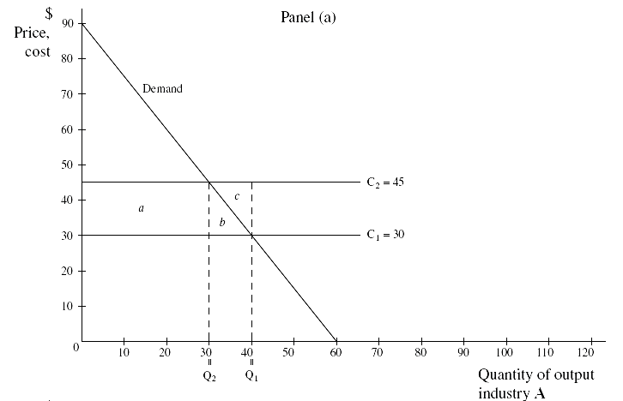
Figure 8-1
P = 90 – 1.5Q
LO5

Slide 18
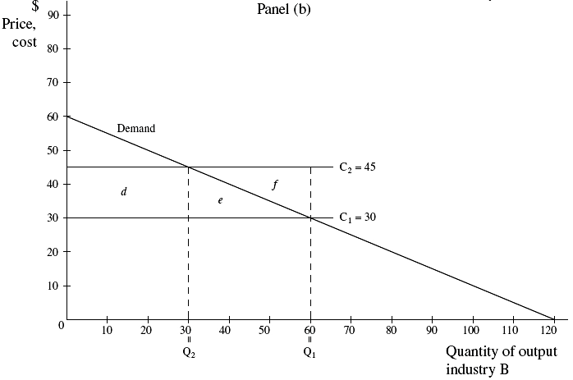
Figure 8-1
P = 60 – .5Q
LO5

Slide 19
Tax incidence

Slide 20
Practice Exercise

Slide 21
Chapter Overview
This chapter provided an overview of the way costs are estimated in cost-benefit analysis.
The fundamental concept of social opportunity costs was discussed.
Introduction of the with-without principle and its relation to benefit-cost analysis was described.
Social and private costs of a project were compared and practically applied to a scenario.
The incidence of a policy was defined and illustrated graphically to show how costs of new environmental regulations are distributed.

